Slide 1



presentation to ceo and cfo of budweiser
analysis of beers, breweries, ABV & IBU
Todd garner DS6306 – Study case 1

Slide 2
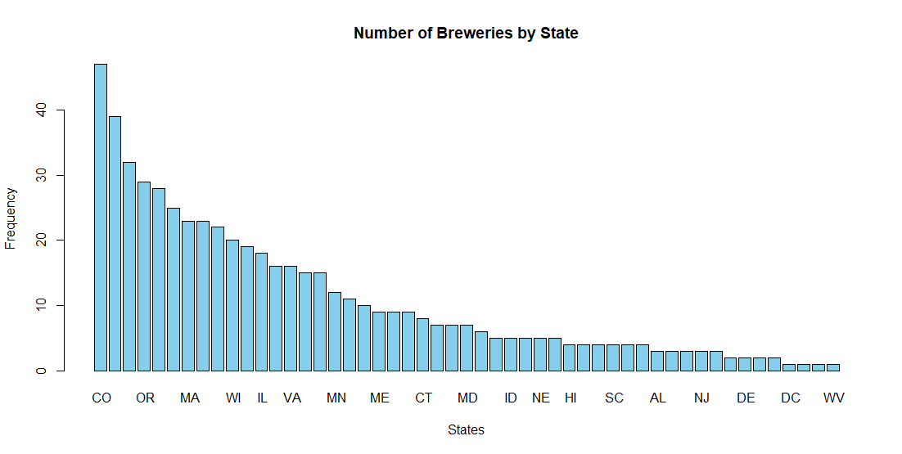
How many breweries per state?

Slide 3
addressing the missing data
1005 missing IBU values – 2,410 total data observations:
"IBUs are really interesting, but for the most part, we try not to emphasize them too much in anything consumer-facing,” said Gonzalez. “It’s not really relevant to your enjoyment of the product, and we’re constantly hearing about IBUs across the industry being used an important stat when describing beer. Stone uses IBUs as an important quality control too, like most breweries, and while the consumer certainly wants to see it, we’re not making new beers to hit a certain IBU threshold.”
Conclusion: IBU is important for Brewers, but not particularly relevant to the consumer.
Result: I’ve taken the average of the data set and inserted that value in the missing data so as not to skew the data averages.

Slide 4
Address the missing data
Missing values ABV: 62 values out of 2,410 observations.
2.5% of the data is missing
Conclusion: likely randomly missing data.
Result: Given extended time, determine what the values are by looking on company web sites.
Temp Solution: Set them equal to the mean of the data present

Slide 5
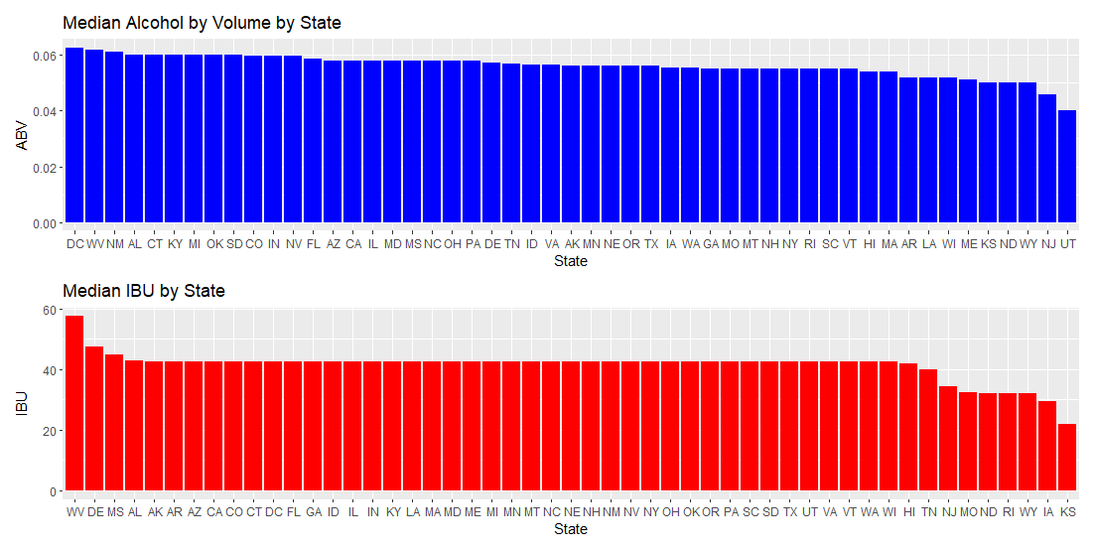
median values for abv and ibu by state

Slide 6
Max ABV & most bitter IBU beers
MAX: 52 Lee Hill Series Vol. 5 - Belgian Style Quadrupel Ale 12.8% ABV Boulder , CO
MOST BITTER: 375 Bitter Bitch Imperial IPA 138 IBU American Double / Imperial IPA Astoria Brewing Company Astoria OR

Slide 7
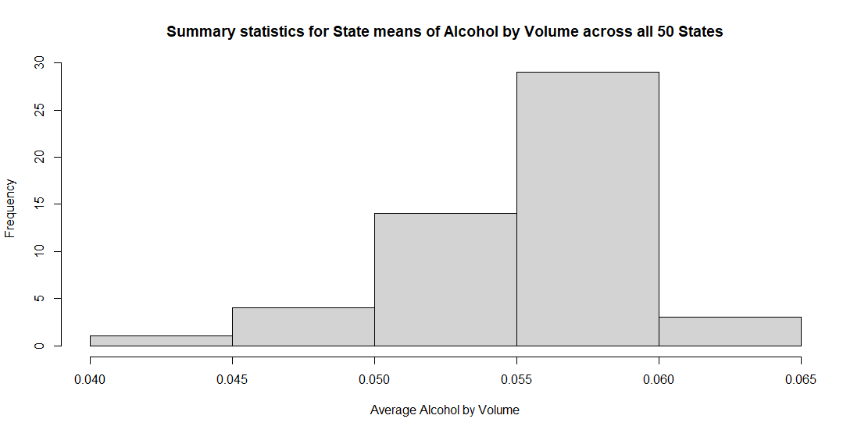
Comments on summary statistics and distribution Alcohol by volume for beers
MIN: 0.10%
MAX: 12.8%
MEAN: 5.977%
MEDIAN: 5.7%

Slide 8
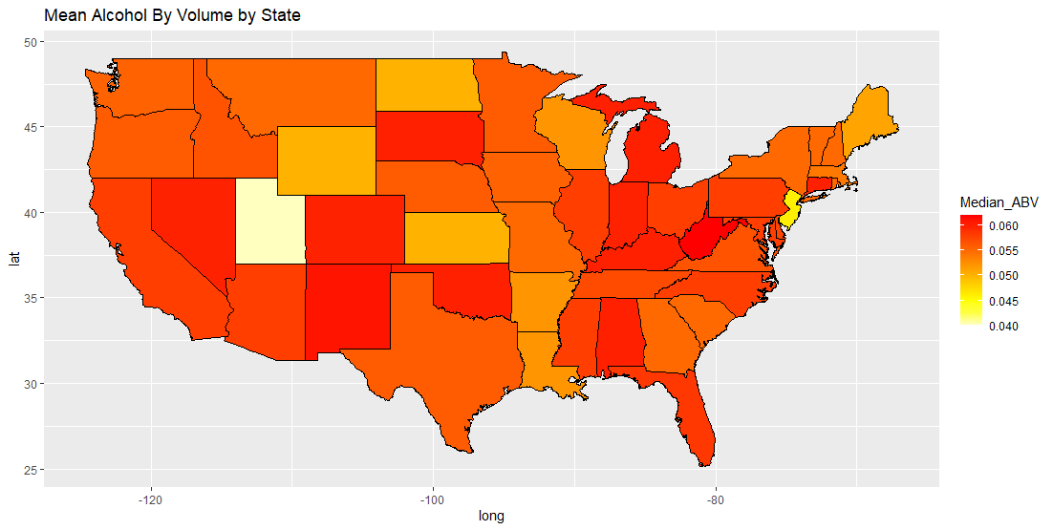

Slide 9
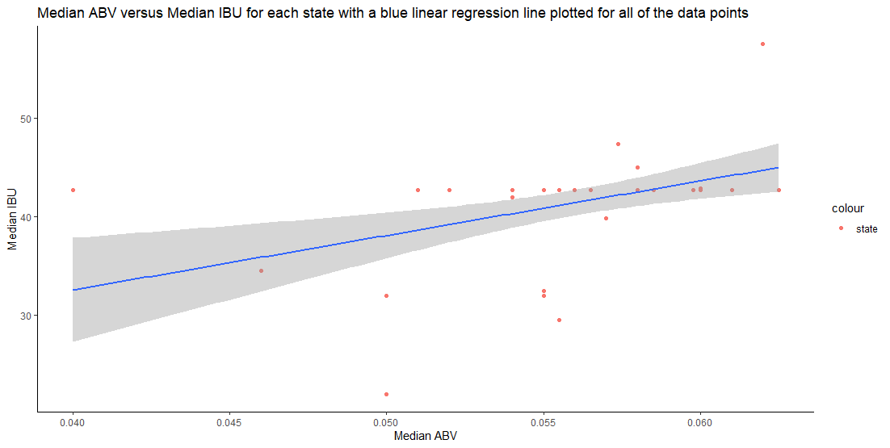
relationship between abv and ibu

Slide 10
THANK YOU!!!
THANK YOU FOR YOUR TIME AND YOUR BUSINESS!!!!
MORE TO COME NEXT WEEK!
TODD GARNER – PINNACLE ECONOMICS, LLC
TODDG@SMU.EDU
CASE STUDY 1 – DS 6306

